Slide 1
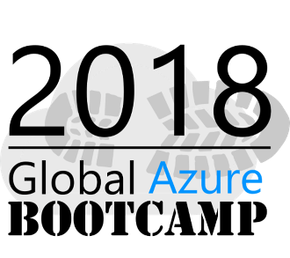
Azure Application Insights and Jupyter Notebook to analyze large scale data
Notes:
Not just any monitoring, but proactive monitoring! The kind that helps you and your team identify issues before your users have a chance to tweet, email or instagram that issue that affects their smooth user experience
Developers are delighted, Operations teams are ecstatic and managers can finally focus on creating awesome teams and products instead of firefighting issue after issue. Visual Studio (Code) tooling, intelligent monitoring, advance analytics, dependency maps and devops integration are some of the awesome features that AppInsights have to offer
. Don't believe me? Great! Join me in this session and let me prove you wrong!
apparantly all of you here like the topic appinsights welcome all

Slide 2
Who am I?
Senior Tech Lead at 99X Technology
MVP – Visual studio and related technologies
Top Contributor on Stack overflow https://stackoverflow.com/users/1749403/sajeetharan
Opensource Contributor
https://github.com/sajeetharan
Angular Enthusiast
https://stackblitz.com/@sajeetharan
Tweet me @kokkisajee

Slide 3
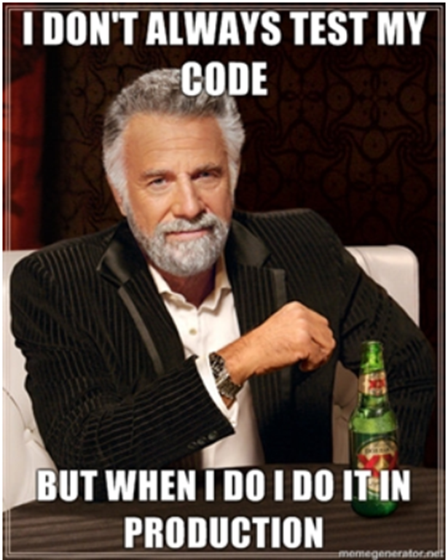

Here is a small story….
Notes:
How many of you are developers here and how many of you agree with the first image? Those who agreed should be really lucky to work in the same company, because 2nd image shows the reality.
Story -> “The application crashed every time I am drinking coke. And when ever it happens, I have restart the browser and enter all the details from the beginning. Please look into the issue and resolve is ASAP”
Two weeks gone and the customer gets angry , qa team also tried to do the same.
Time out procedure in application and it was never tested before and there was a bug.

Slide 4
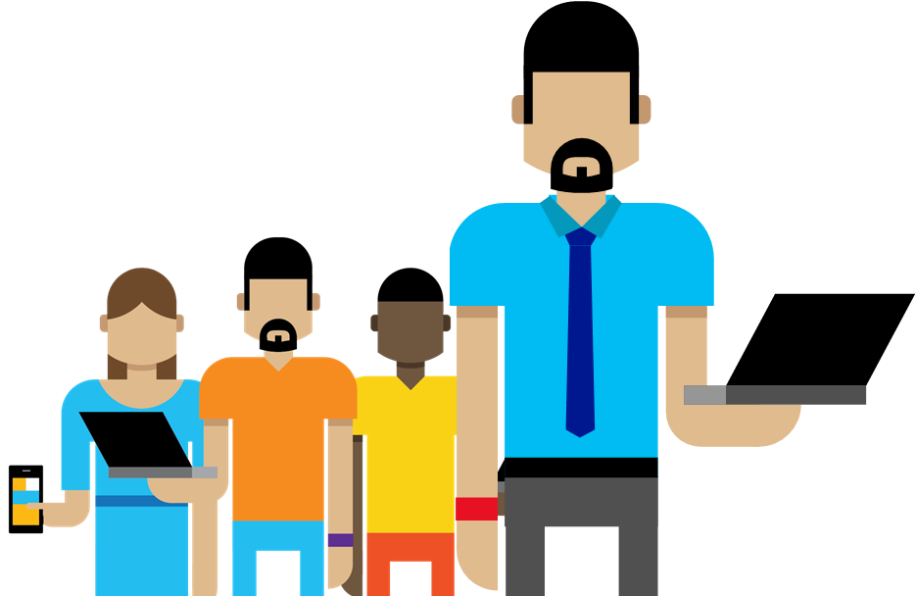
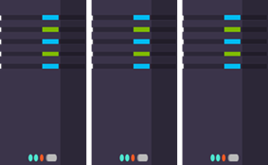
Why Logging ?
1
Trouble Shooting
Did a problem occur? Where? When?
2
Performance/Cost
Application slow? How many requests?
3
Analyze Trends
Need more storage? Need more servers?
4
Customer experience
Is your system making everyone happy?
5
Business decisions
Increase in sales?
Notes:
One who manage 24/7 operations, every applications are different at different situations that is why this topic is important.
logs to a file somewhere on the file and distributed to customers who never looked at it again and some of them dint have idea on what to look at when they have problems. all these takes time to identify the problem
today we have very different sitaution each system has beocme massi bunch of things, any one in this room build application with just two components ? there are lot of moving pars
there are lot of components in it, authentication,authorization,identity management so that becomes a service in the cloud some sort of azure ad, auth0 OR sas providers. storage (blobs,cdns). eventhubs queues
to sort of distribute our architecture. we got telematery of data coming from all over the place.
hello world is not what it used to be , there a lot of things flying around all over the place one of the
obvious thing to manage is to log all the things. discover upfront.

Slide 5
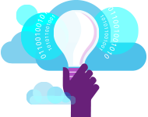
What is Application Insights?
“Application Insights is an extensible Application Performance
Management (APM) service for web developers on multiple
Platforms”.
1
3
Telemetry is collected at each tier: mobile applications, server applications and browser
Get a 360° view of the application including availability, performance and usage patterns
2
Telemetry arrives in the Application Insights service in the cloud where it is processed & stored

Slide 6
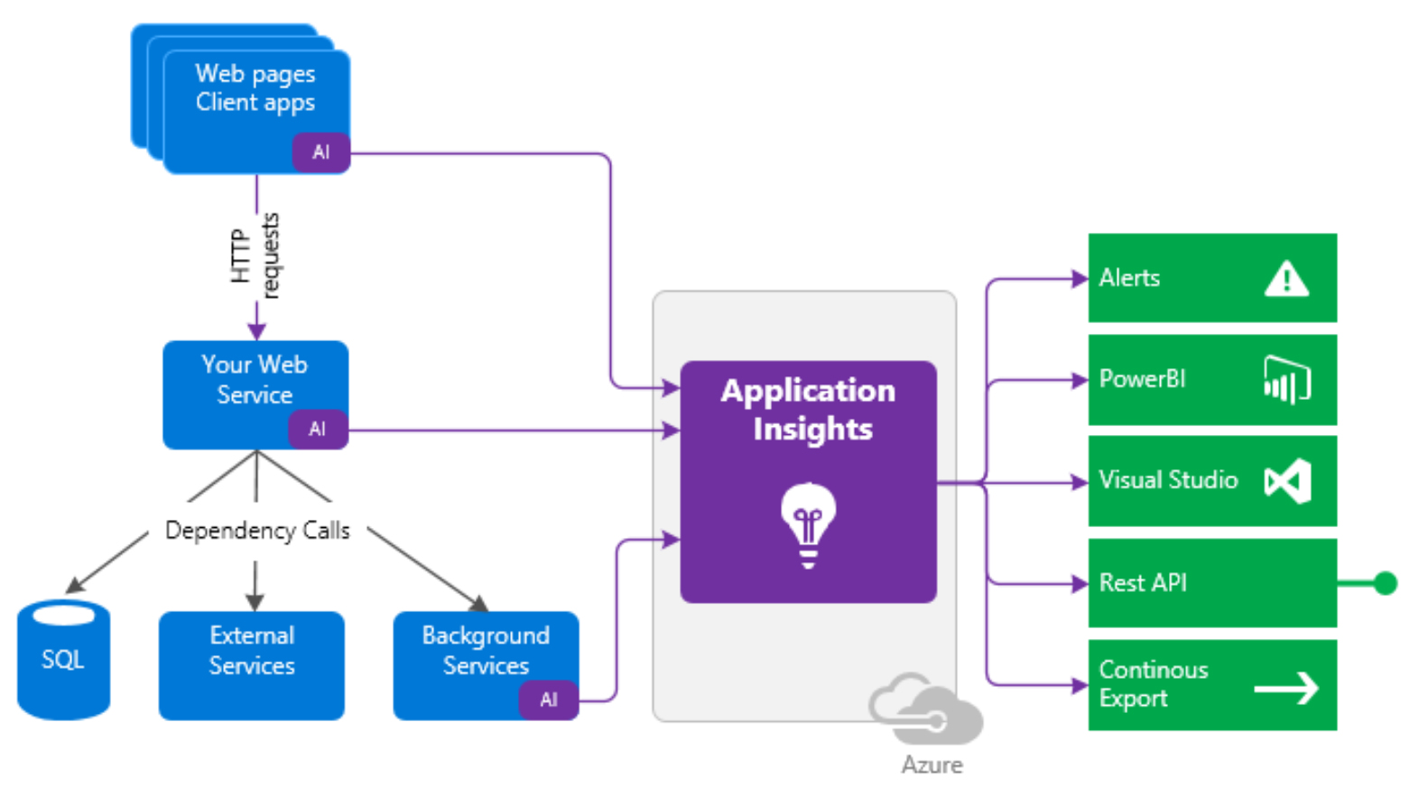
How it works?

Slide 7




Sources of Telemetry
1
Outside-in monitoring
URL pings and web tests from 16 global points of presence
2
Observed user behavior
How is the application being used?
3
Developer traces and events
app
Whatever the developer would like to send to Application Insights
4
Observed application behavior
platform
No coding required – service dependencies, queries, response time, exceptions, logs, etc.
infrastructure
Infrastructure performance
5
System performance counters

Slide 8

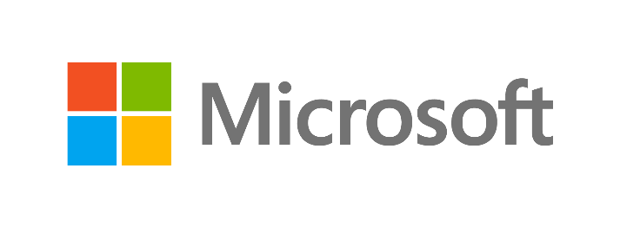







Key capabilities
Any app support
Easily add analytics across multiple platforms including: ASP.NET, Java/J2EE, iOS, Android, Windows, as well as OSS technologies such as Node.JS, PHP, Ruby, Python, etc.
Open source SDK: https://github.com/Microsoft/ApplicationInsights-Home
Logging framework: Log4Net, nLog, System.Diagnostics Log4J, Logback

Slide 9
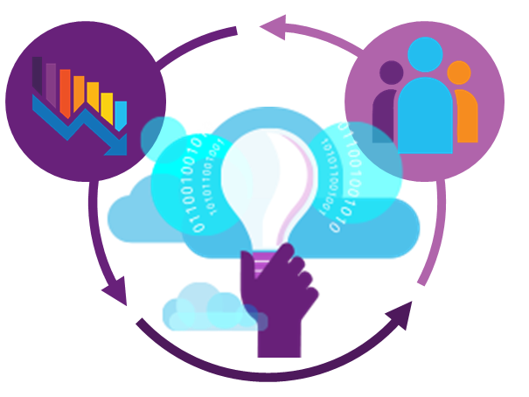
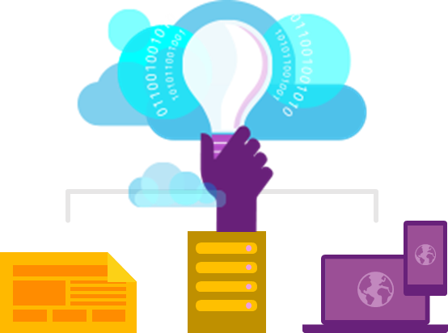
Key capabilities
360° View Across
Availability, Performance & Usage
Overall app health via Overview Blade
Quickly correlate performance & usage data
Detailed insights with a click of a button through intuitive data exploration
Fast & Powerful Diagnostics & Usage Insights
Quickly diagnose availability & performance issues
Learn & improve continuously with usage insights
Extend your telemetry data
Export your data for further analysis
Built-in Analytics
for any app
Supports any app type
Zero-click enablement
No-touch monitoring

Slide 10
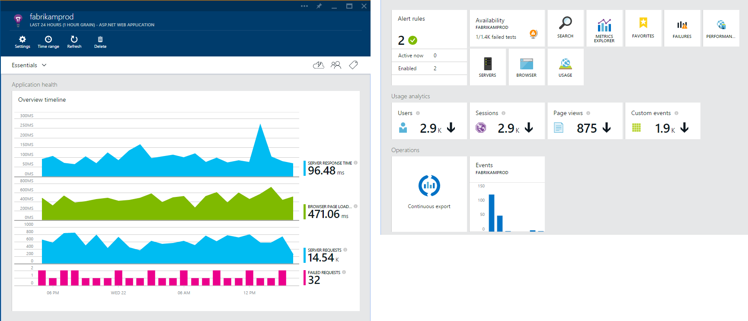
Overview Blade
Out of the box experience
Provides a summary of the application’s health - availability, performance and usage
Paired timeline allows users to quickly correlate metrics and identify trends

Slide 11
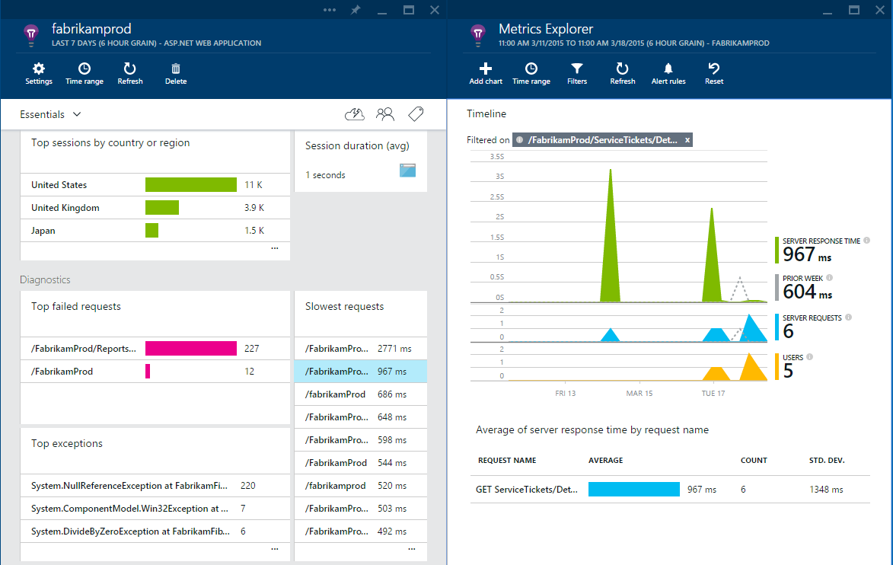
Drill down
Detailed insights with the click of a button
Correlate performance and usage in a single view
Pinpoint problems and investigate questions like “Do I have network performance issues that hurt user adoption?”
Click on specific metric and drill into detailed information and answer questions such as “what request is failing the most?”

Slide 12
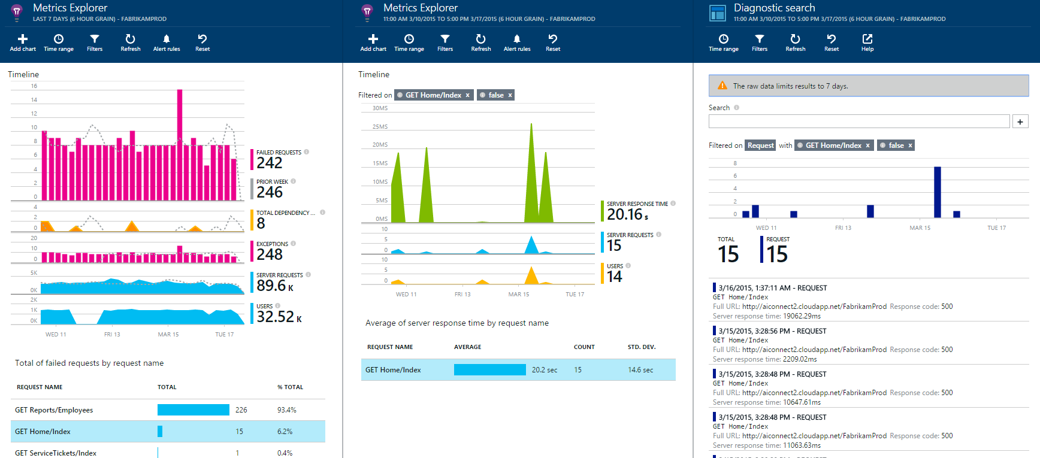
Drill down tools
Powerful insights with Metrics Explorer and Diagnostic Search
Metrics Explorer provides a flexible multi-dimensional UI over custom and out-of-the-box telemetry collected
Diagnostic Search enables efficient search over large sets of data using the query experience

Slide 13
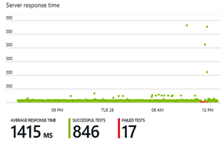
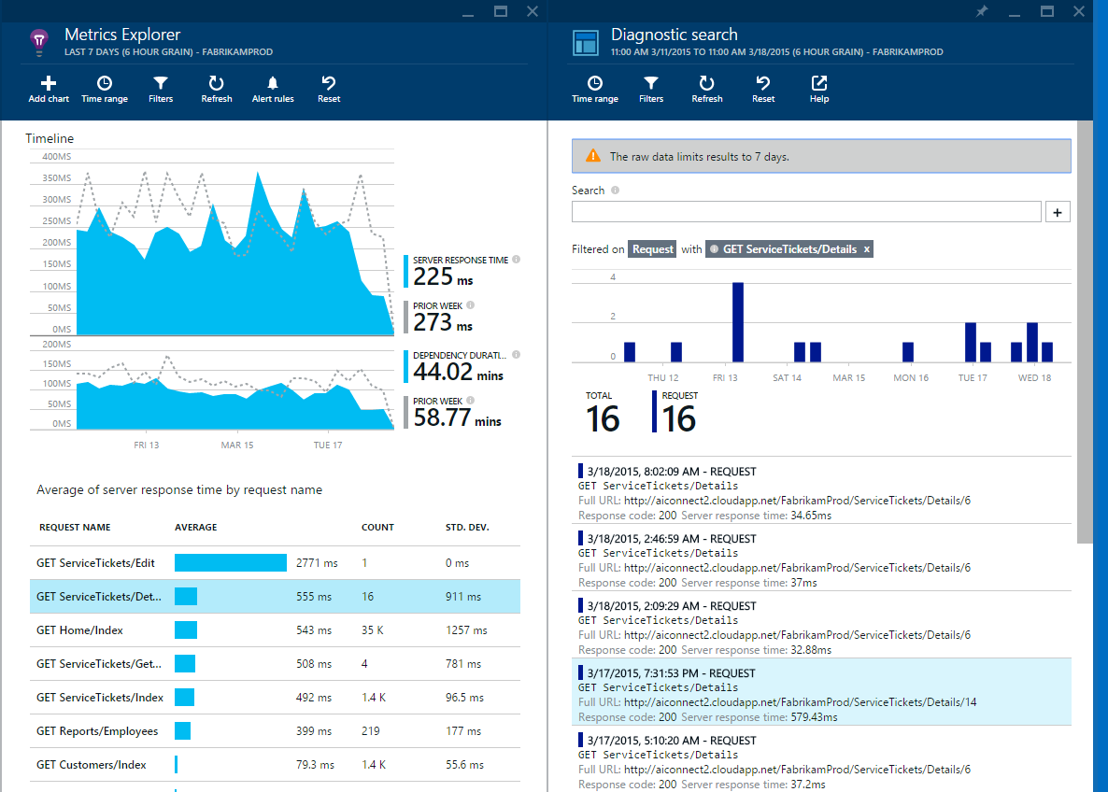
Fast and powerful insights
Identify & triage availability issues
Diagnose & solve performance problems
Mobile crash/sever exception analytics
Notes:
Monitor your web sites with simple pings to complex web tests from points around the world
Quickly diagnose issues by accessing rich application performance data from the client view to dependencies
Real time view of crashes happening on devices, allowing you to focus on fixing key issues with the biggest impact first

Slide 14
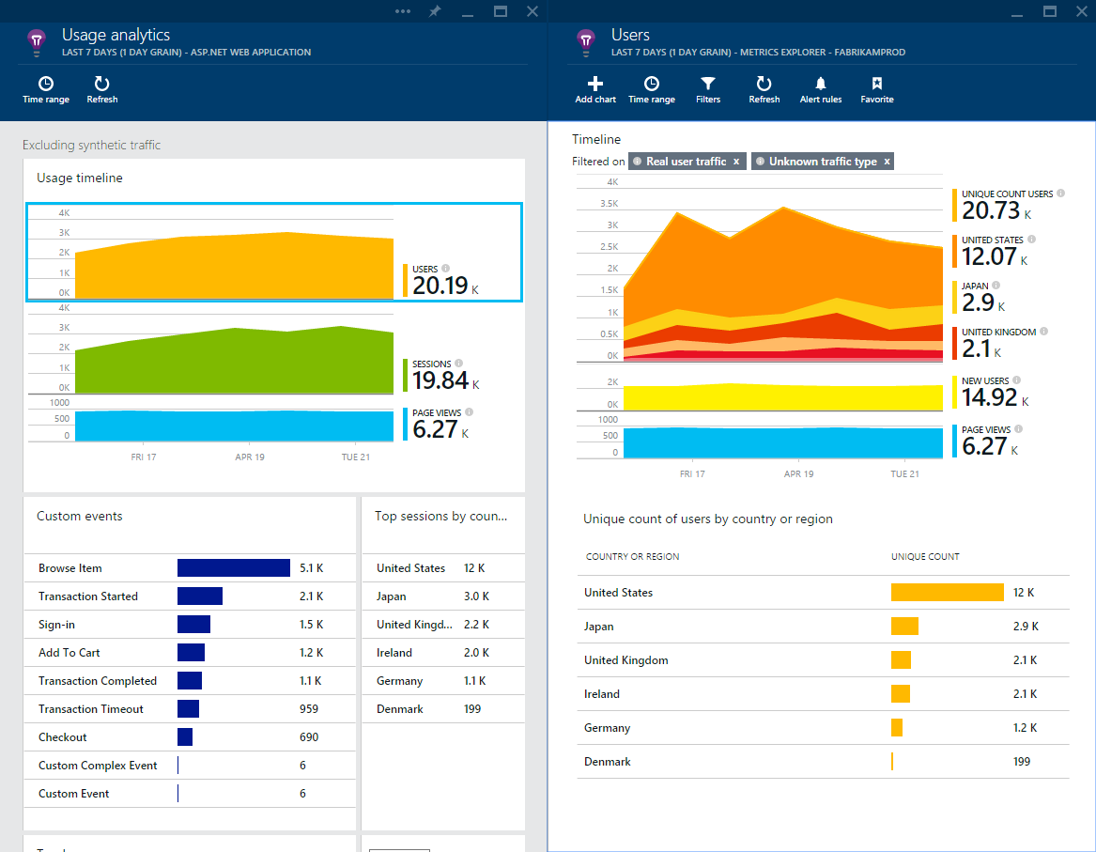
Fast and powerful insights
Learn & improve with usage insights
Notes:
Understand where your users are coming from and where they spend most of their time
Prioritize future investments and continuously improve your app based on user activity and usage patterns and trends

Slide 15
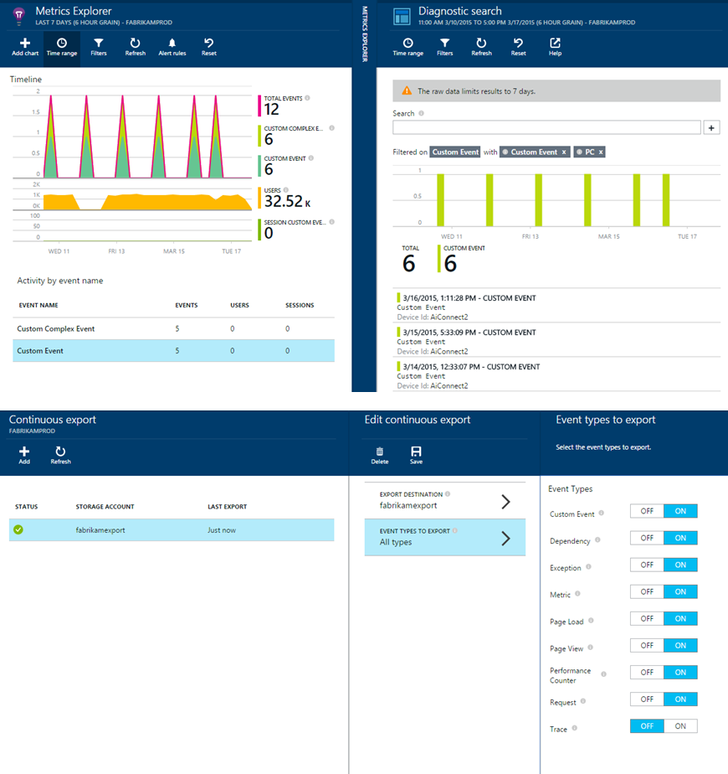
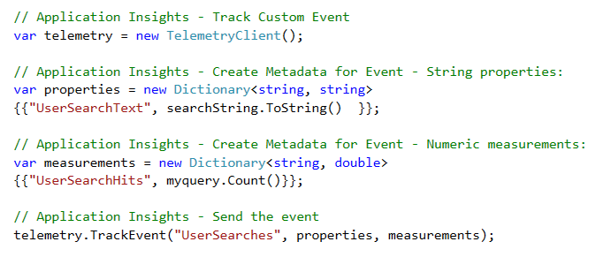
Fast and powerful insights
Extend telemetry data
Add custom metrics and events to better track and analyze user activity
Continuously Export data to Azure Blob Storage for custom integration with other data sources and further analysis

Slide 16
What is Jupyter Notebook
“Open source web application to create and share documents that contain live code, equations, visualizations and explanatory text."
1
Language of choice
Edit and run notebooks via a web browser
2
Big data integration
The kernels and a dashboard

Slide 17

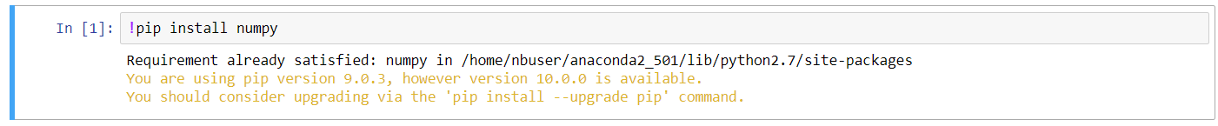
Here comes Azure Notebook
3
Great for sharing and collaborative work
1
Great memo pad - Write code like a sticky note
2
Execute in units of cells

Slide 18
Let’s code
Add Azure Application Insights to your ASP.NET Core web application
Dive into azure notebook with data analysis
AppInsights with azure notebook saves the day

Slide 19
Who wants some stickers?
Q & A

Slide 20
Where to go from here….
Access the demo and slides
https://github.com/sajeetharan/AzureBootCampAppInsights
Rate my session
https://www.rateevent.com/speeches/SCAAA663

